Slide 1
Project Proposals

Slide 2
Project Proposal
Now that project selection methods have been discussed, it is appropriate to consider what documentation is needed to evaluate a project that is being considered.
The set of documents submitted for evaluation is called the project proposal

Slide 3
Project Proposal
Several issues face ﬁrms preparing proposals, particularly ﬁrms in the aerospace, construction, defense, and consulting industries. These are:
Which projects should be bid on?
How should the proposal-preparation process be organized and staffed?
How much should be spent on preparing proposals for bids?
How should the bid prices be set? What is the bidding strategy? Is it ethical?

Slide 4
Project Proposal
All proposals should begin with a short summary statement (an “Executive Summary”) covering the fundamental nature of the proposal in minimally technical language , as well as the general beneﬁts that are expected.
All proposals should be accompanied by a “cover letter.” Roman (1986, pp. 67–68) emphasizes that the cover letter is a key marketing document and is worthy of careful attention.

Slide 5
Project Proposal
(1) the nature of the technical problem and how it is to be approached;
(2) the plan for implementing the project once it has been accepted
(3) the plan for logistic support and administration of the project
(4) a description of the group proposing to do the work, plus its past experience in similar work.

Slide 6
Project Proposals
Problem
Vision
Benefits
Deliverables
Success Criteria
Deadlines/Plan/Approach
Budget/Cost

Slide 7
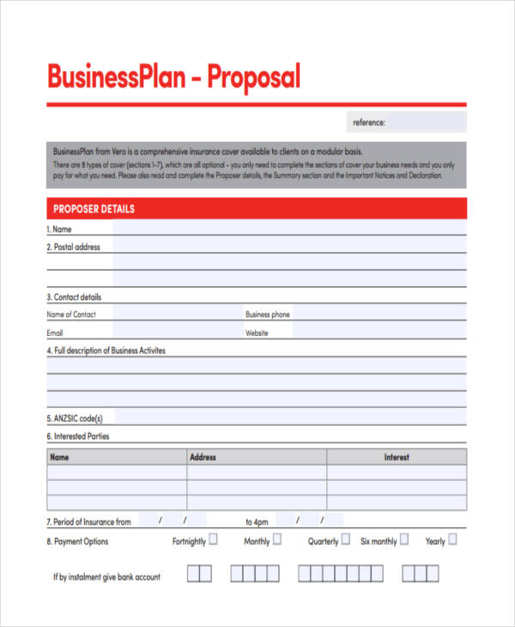
Business Plan Proposal

